Slide 1
Facility Planning and Layout
Jahid Hasan
Assistant Professor
Dept. of IPE,SUST
1

Slide 2
Facilities Planning
Facilities are the plant and the office within which P/OM does its work.
There are four main components of facilities planning and they strongly interact with each other.
Location of plant, or the branch, or the warehouse.
Specific structure and site.
Layout.
Furniture, lighting, decorative features, and equipment.
In the global world of international production systems, international markets, and rapid technological transfers, facilities planning requires a team effort.

Slide 3
Location
Six factors that can affect location decisions are:
Process inputs.
Process outputs.
Process requirements.
Personal preferences.
Governmental issues.
Site and plant availabilities.
Service industries locate close to their customers.
Extractors like to be close to their raw materials.
Fabricators like to be close to their raw materials and customers.
Assembly plants try to keep their component suppliers close-by.
Best location is related to the function of the facility and the characteristics of its products and services.

Slide 4
Models for Facility Location
Location decision models use measures of costs and preferences.
These models include:
Transportation models
Scoring models use combinations of costs and preferences.
Breakeven analysis
Center of gravity model (not discussed in this presentation)
Columbus, Ohio, is a popular distribution center because a circle around it within a 600-mile radius encloses a large percentage of U.S. retail sales. 61% of the US population and 63% of US manufacturing facilities lie within 600 miles of Columbus Ohio. Such a large market cannot be reached from any other state (www.conway.com/oh/distribution/ohiobody.htm).
www.conway.com/oh/distribution/ohiobody.htm

Slide 5
Structure and Site Selection
Location, sites and structure decisions can be made both sequentially and simultaneously.
Work configuration influences structure decisions.
  Flow shop
  Job shops
  Service industries are often associated with particular kinds and shapes of structures.
Airports, hospitals, theaters, and educational institutions typify the site-structure demands for service specifics.

Slide 6
Location– Scoring Models
Location Factors and Weights
The scoring model of facility location provides a relative weight to each factor that affects the location decision.
The objective is to choose the location considering all relevant factors.
A six step process for using the scoring model for the hypothetical data given in the table on RHS is described below.
Step 1: List all factors that affect the location decisions.
Step 2: Assign a weight to each factor.
Step 3: Identify alternative locations. Chile, Mexico, Honduras and Brazil are identified are the potential locations for this problem.
Factor Name | Weight
Labor Productivity | 0.15
Nearness to Markets | 0.18
Nearness to Sources of Raw Material | 0.25
Infrastructure Facilities | 0.12
Transportation Facilities | 0.08
Power Availability | 0.08
Political Climate | 0.03
Labor Unions | 0.02
Labor Cost | 0.04
Material Cost | 0.05
Total | 1.00

Slide 7
Location– Scoring Models (continued)
Step 4: Each alternative is evaluated and is given a score on a ten point scale (it could be a 100 point scale) for each alternative.
Step 5: The total score for each location is calculated by multiplying the weight of each factor by the points it earned (weight x score) and then adding this number for all factors.
Step 6: The total score for each location is calculated and then the location with the highest score is selected.
For this problem, the scores are: Chile (5.31), Mexico (5.51), Honduras (4.64) and Brazil (6.52). Therefore, Brazil is the most attractive location based on these factors.

Slide 8
Location– Scoring Models (continued)
Evaluation of Various Location Sites
The score for each location and for each factor is given in the table on RHS.
For example, for labor productivity, Chile scored 8 points, Mexico scored 7 points, Honduras scored 3 points and Brazil scored 6 points.
Illustration of calculations for total score for Chile are given below.
Score for Chile = 5.31
= (0.15 x 8) + (0.18 x 4) + (0.25 x 3) + (0.12 x 7) + (0.08 x 6) + (0.08 x 5) + (0.03 x 9) + (0.02 x 3) + (0.04 x 6) + (0.05 x 7).
Scoring Model
 |  |  | Location Alternatives
 |  |  | Chile | Mexico | Honduras | Brazil
Factor Name | Weight |  | Score out of 10
Labor Productivity | 0.15 |  | 8 | 7 | 3 | 6
Nearness to Markets | 0.18 |  | 4 | 6 | 9 | 7
Nearness to Sources of Raw Material | 0.25 |  | 3 | 5 | 2 | 8
Infrastructure Facilities | 0.12 |  | 7 | 3 | 4 | 4
Transportation Facilities | 0.08 |  | 6 | 6 | 7 | 9
Power Availability | 0.08 |  | 5 | 8 | 6 | 7
Political Climate | 0.03 |  | 9 | 9 | 8 | 8
Labor Unions | 0.02 |  | 3 | 4 | 3 | 3
Labor Cost | 0.04 |  | 6 | 5 | 5 | 5
Material Cost | 0.05 |  | 7 | 2 | 1 | 2
Total (weighted sums) | 1.00 |  | 5.31 | 5.51 | 4.64 | 6.52

Slide 9
Facilities Layout
Layout is the physical arrangement of facilities within a manufacturing plant or a service facility.
The layout of a plant/service facility specifies where various machines, equipment and people will be placed.
Layout affects the productivity and costs of transportation (materials handling) within the plant.
Layout is an interior design problem that strongly interacts with structure and specific site selection and equipment choice.

Slide 10
Facilities Layout (continued)
There are at least the following five basic types of layouts:
  Job shop process layouts.
  Product-oriented (Flow shop) layout.
  Cellular layout.
  Group technology layout.
  Hybrid (mixed layouts) - combinations of product and process layouts
Change in technology and even in purpose should lead to reexamination of layout decision.

Slide 11
Layout Criteria
Seven measures of layout effectiveness include the following:
Capacity—throughput rate. Goal: Maximize total output volumes and throughput rates.
Balance—for perfect balance, the throughput rates of consecutive operations are 100% aligned and synchronized. Goal: Perfect balance.
Amount of investment and operating costs. Goal: Minimum expenditures.
Flexibility to change layouts. Goal: Maximize ease of change.
Amount of work in process (WIP). Goal: Minimize units of inventory.
Distance that parts travel; saving an inch traveled thousands of times per day sums to sizeable savings. Goal: Minimize total travel time and distance.
Storage for WIP and how much handling equipment is required to move parts from one place in the facility to another. Goal: Minimize space used for storage and minimize moving equipment.

Slide 12
Types of Layouts
Four basic layout types consisting of:
  Process layouts - Group similar resources together
  Product layouts - Designed to produce a specific product efficiently
  Hybrid layouts - Combine aspects of both process and product layouts
  Fixed-Position layouts - Product is two large to move; e.g. a building
© Wiley 2010

Slide 13
Process Layouts
Process layout unique characteristics include:
  Resources used are general purpose
  Facilities are less capital intensive
  Facilities are more labor intensive
  Resources have greater flexibility
  Processing rates are slower
  Material handling costs are higher
© Wiley 2010

Slide 14
Process Layouts – con’t
Scheduling resources & work flow is more complex
Space requirements are higher
© Wiley 2010

Slide 15
Product Layouts
Product layout unique characteristics are:
  Resources are specialized
  Facilities are capital intensive
  Processing rates are faster
  Material handling costs are lower
  Space requirements for inventory storage are lower
  Flexibility is low relative to the market
© Wiley 2010

Slide 16
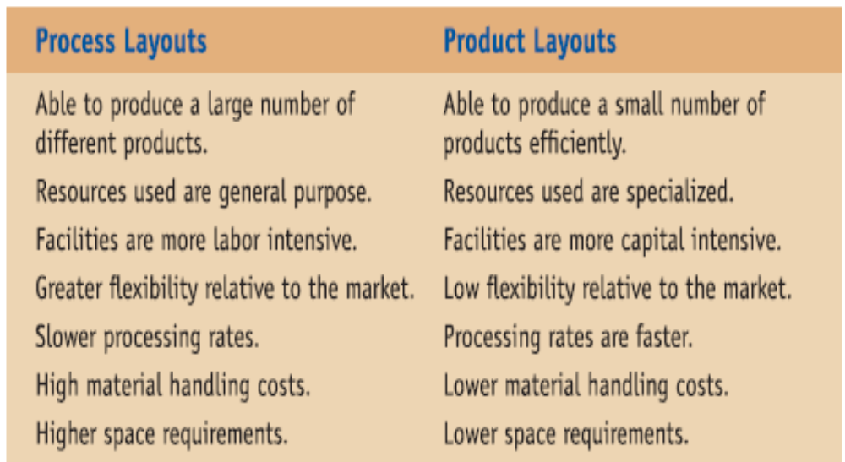
Process vs. Product Layouts
  Here are the characteristic differences between a process and product layout.
© Wiley 2010

Slide 17
Hybrid Layouts
Combine elements of both product & process layouts
  Maintain some of the efficiencies of product layouts
  Maintain some of the flexibility of process layouts
Examples:
  Group technology & manufacturing cells
  Grocery stores
© Wiley 2010

Slide 18
Fixed-Position Layout
Used when product is large
Product is difficult or impossible to move, i.e. very large or fixed
All resources must be brought to the site
Scheduling of crews and resources is a challenge
© Wiley 2010

Slide 19
Designing Process Layouts
Step 1: Gather information:
  Space needed, space available, identify closeness measures
Step 2: Develop alternative block plans:
  Using trial-and-error or decision support tools
Step 3: Develop a detailed layout:
  Consider exact sizes/shapes of departments and work centers including aisles and stairways
  Tools like drawings, 3-D models, and CAD software are available to facilitate this process
© Wiley 2010

Slide 20
Special Cases of Process Layouts
A number of unique process layouts require special attention. We will look at two of these:
Warehouse layouts
Office Layouts
© Wiley 2010

Slide 21
Warehouse Layouts
Warehouse Layout Considerations:
  Primary decision is where to locate each department relative to the dock
  Departments can be organized to minimize “ld” totals
  Departments of unequal size require modification of the typical ld calculations to include a calculation of the “ratio of trips to area needed”
  The usage of “Crossdocking” modifies the traditional warehouse layouts; more docks, less storage space, and less order picking
© Wiley 2010

Slide 22
Office Layouts
Office Layout Considerations:
  Almost half of US workforce works in an office environment
  Human interaction and communication are the primary factors in designing office layouts
  Layouts need to account for physical environment and psychological needs of the organization
  One key layout trade-off is between proximity and privacy
  Open concept offices promote understanding & trust
  Flexible layouts incorporating “office landscaping” help to solve the privacy issue in open office environments
© Wiley 2010

Slide 23
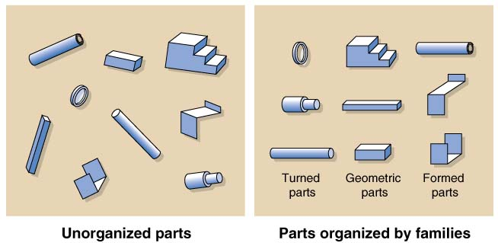
Group Technology (CELL) Layouts
One of the most popular hybrid layouts uses Group Technology (GT) and a cellular layout
GT has the advantage of bringing the efficiencies of a product layout to a process layout environment
© Wiley 2010

Slide 24
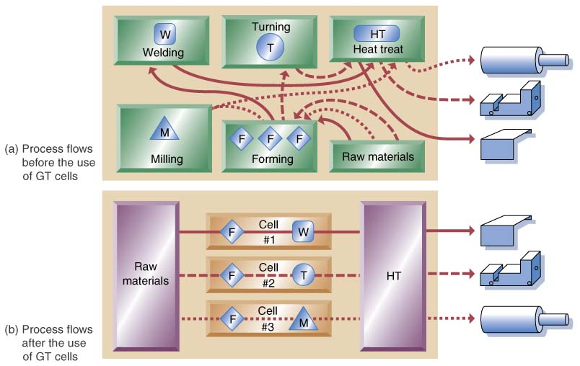
Process Flows before the Use of GT Cells
© Wiley 2010

Slide 25
Process Flows after the Use of GT Cells
© Wiley 2010

Slide 26
Layout Models
Floor Plan Models (drawings) are graphic methods of trial and error that are used by interior decorators.
Load-distance models examine alternative layout plans to minimize cost of moving material on the shop floor.
Some considerations while designing layouts include:
Job shops and the batch production environment are subject to major changes in the product mix.
A few order types may dominate the job shop that may require a mix of product layouts (for dominating jobs) with process layouts for other jobs.
If the character of the batch work changes a great deal over time, it is best to go for the most general form of process layout.
Flexibility is desirable but expensive and disruptive to keep moving equipment around the plant.
Modular office layouts have remarkable flexibility for making quick changes.

Slide 27
Thank you

